Slide 1


Weather Forecasting Prediction
By,
Asha Belcilda

Slide 2


Agenda
Introduction to Weather Forecasting Analysis
Data Collection and Preprocessing
Feature Extraction and Selection
Model Training and Evaluation
Deployment and Maintenance
Conclusion

Slide 3

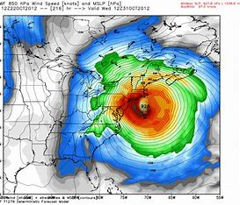
Introduction to Weather Forecasting Analysis
Weather forecasting is the use of science and technology to predict the future state of the atmosphere. Machine learning is a powerful tool that can help us analyze and understand the data collected from weather forecasting.
Machine learning algorithms can be used to improve the accuracy of weather forecasts and to provide more accurate predictions. This presentation will discuss the use of machine learning for weather forecasting analysis.

Slide 4
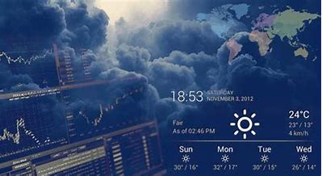
Data Collection and Preprocessing
Data collection and preprocessing is the first step in any machine learning project. Weather data must be collected from various sources and preprocessed before it can be used for analysis.
Weather data can be collected from satellites, weather stations, and other sources. Once the data is collected, it needs to be preprocessed to ensure that it is in the correct format for the machine learning algorithm to process.

Slide 5

Feature Extraction and Selection
Feature extraction and selection is the process of selecting the most relevant features from the data. This is done to reduce the complexity of the data and to ensure that only the most important features are used.
The features selected should be relevant to the task at hand and should be able to provide the most accurate predictions. This process can be done manually or using automated feature selection algorithms.

Slide 6
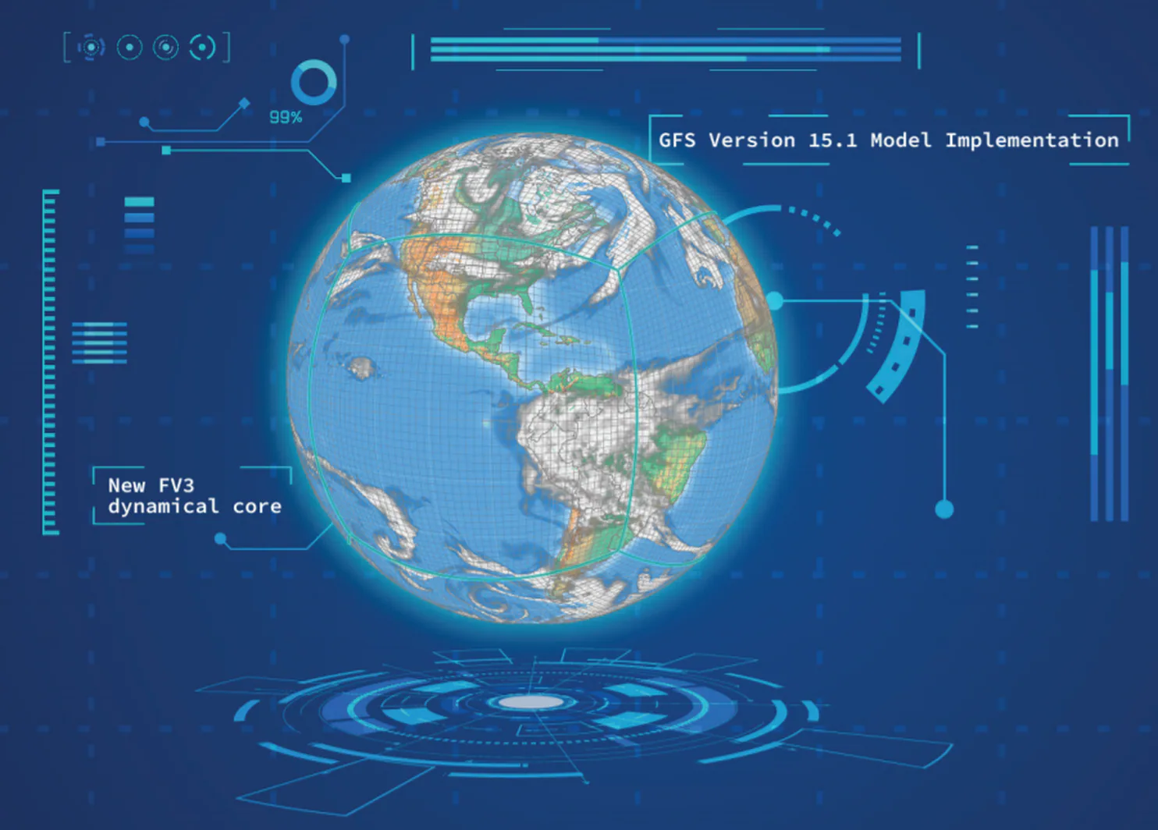
Model Training and Evaluation
Once the data has been preprocessed and the features have been selected, the next step is to train and evaluate the model. Different machine learning algorithms can be used to train the model and to evaluate its performance.
The model should be evaluated on a variety of datasets to ensure that it is able to accurately predict the future state of the atmosphere. The performance of the model should be monitored over time to ensure that it remains accurate

Slide 7
Deployment and Maintenance
Once the model has been trained and evaluated, it needs to be deployed and maintained. The model should be deployed on a secure server and should be monitored to ensure that it is performing as expected.
The model should also be monitored for any changes in the data that may affect its performance. This will help ensure that the model remains accurate and reliable over time.

Slide 8


Conclusion
Weather forecasting analysis using machine learning can be a powerful tool for predicting the future state of the atmosphere. The process involves collecting and preprocessing data, selecting the most relevant features, training and evaluating the model, and deploying and maintaining the model.
By using machine learning, we can improve the accuracy of our weather forecasts and provide more accurate predictions. This will help ensure that we are better prepared for any changes in the weather.

